Slide 1

Product Cluster Analysis
By Rajnish Kashyap

Slide 2
Table of Contents
Introduction | This project segments products into meaningful clusters based on sales and distribution behavior patterns.
EDA & Data Wrangling | Explored, cleaned, and transformed raw product data to uncover patterns and prepare for clustering.
Feature Engineering | Created informative features from sales data to enhance clustering accuracy and pattern discovery.
Model Building | Implemented KMeans, DBSCAN, and Agglomerative Clustering to identify natural groupings within product data.
Evaluation | Evaluated clustering performance using Silhouette Score, Calinski-Harabasz Index, and Davies-Bouldin Index.
Finalization | Finalized Agglomerative Clustering based on evaluation results and visualized clusters using PCA projection.

Slide 3

01
Introduction
This project applies unsupervised machine
learning to group similar products based on
historical sales data. By identifying product
clusters, businesses can:
-> Optimize inventory and stock management
-> Tailor promotions and marketing by segment
-> Enhance forecasting and operational efficiency

Slide 4
Problem & Objective
Problem
Businesses manage diverse
products with varying sales behavior
and demand cycles.
Without clustering, this leads to:
➤ Inefficient inventory planning
➤ Poorly targeted marketing
➤ Missed revenue optimization
Opportunities
Objective
Group similar products using
clustering techniques to:
➤ Improve stock management and
forecasting
➤ Enable segment-based
promotions and bundling
➤ Support strategic product
decisions with data

Slide 5
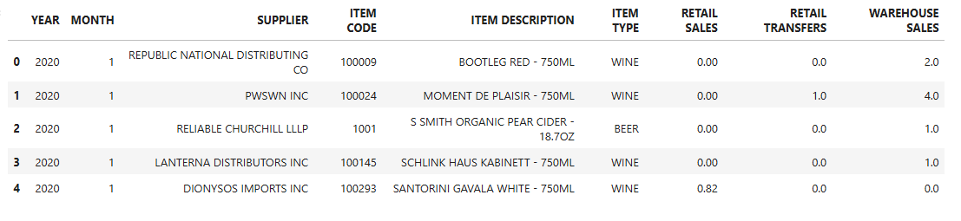
Dataset Overview
Shape: 307,645 rows × 9 columns
Key Columns: Sales metrics (RETAIL SALES, RETAIL TRANSFERS, WAREHOUSE SALES), item details, and date info
Observations:
➤ Sales data is highly skewed with extreme values
➤ Negative sales values may indicate returns or data issues
➤ Retail Transfers are sparse, often zero
➤ Covers multiple suppliers and product types

Slide 6
02
EDA & Data Wrangling
-> Handling Null values
-> Outlier Analysis
-> Data Visualization

Slide 7
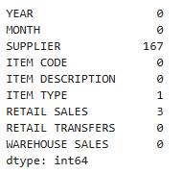
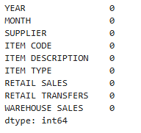
Handling Missing Values
Missing Data Summary:
➤ SUPPLIER: 167 missing
➤ ITEM TYPE: 1 missing
➤ RETAIL SALES: 3 missing
Imputation Strategy:
➤ SUPPLIER and ITEM TYPE filled with 'Unknown' to preserve categorical consistency
➤ RETAIL SALES filled with its median value to reduce the impact of outliers

Slide 8
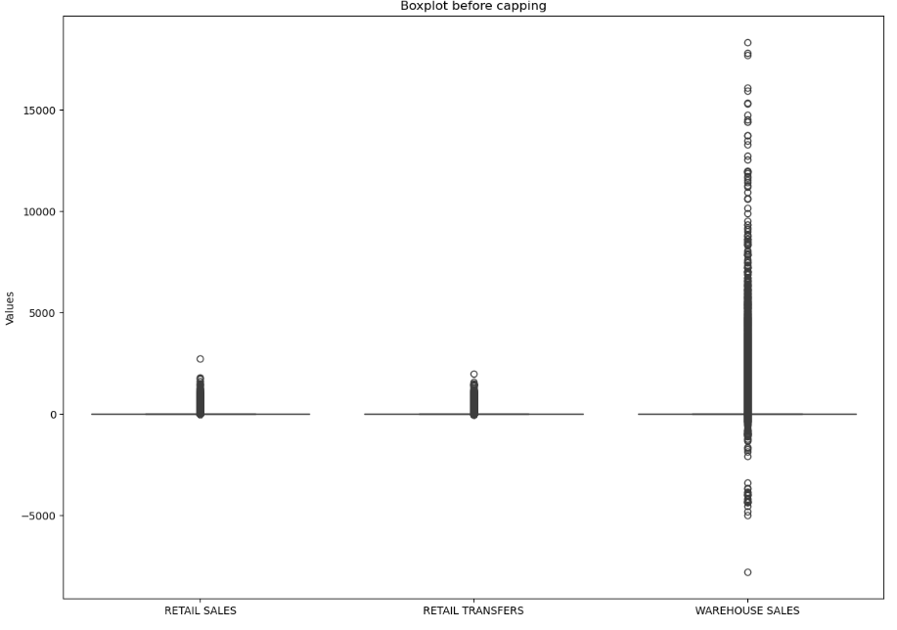
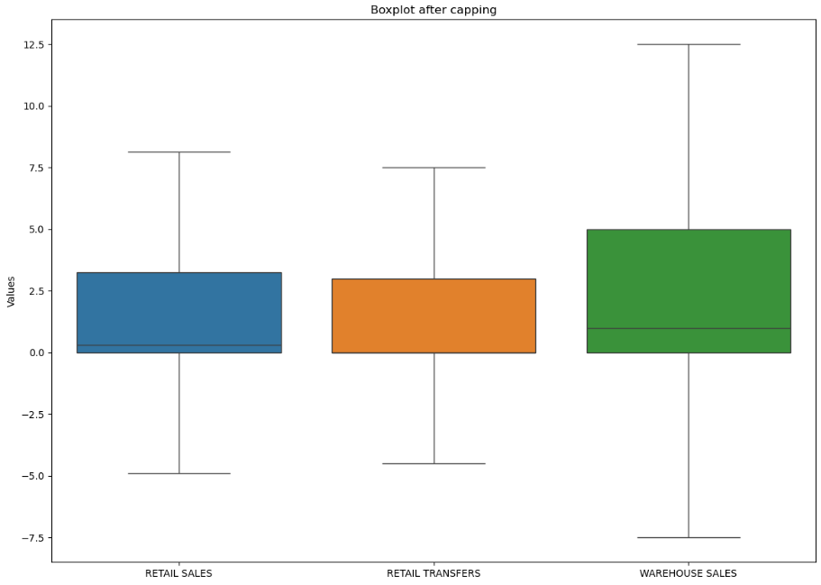
Outlier Analysis
Outlier Analysis Summary
- Boxplot and IQR method used to detect outliers in key sales features.
- Warehouse Sales contains extreme high outliers, significantly skewing the distribution.
- Negative values found across all sales fields, likely due to returns or data issues.
- Retail Sales and Retail Transfers show limited outlier spread with tighter distributions.
- Capping or transformation may be needed to reduce skewness and support effective clustering.

Slide 9
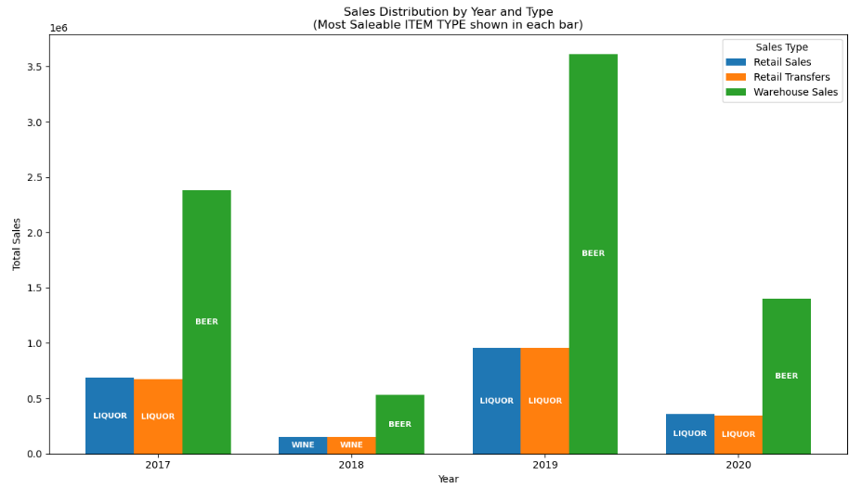
Data Visualization #1
Sales Distribution by Year and Type
(Most saleable ITEM TYPE shown in each bar)
- In 2019, Warehouse Sales peaked sharply, driven predominantly by BEER sales.
- LIQUOR consistently held strong sales through Retail and Transfer channels between 2017–2020.
- BEER emerged as the most dominant product in terms of Warehouse Sales across all years.
- WINE and other categories showed minimal contribution compared to BEER and LIQUOR in all types of sales.

Slide 10
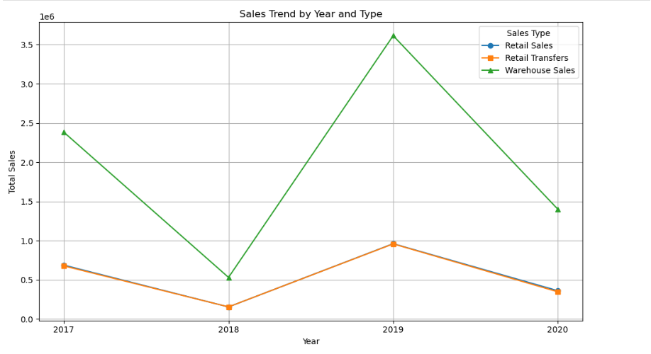
Data Visualization #2
Sales Trend by Year and Type
- All three sales types witnessed a significant dip in 2018 before rising again in 2019.
- Warehouse Sales displayed a much larger magnitude compared to Retail Sales and Retail Transfers.
- Retail Transfers and Retail Sales followed a similar trend over the years, both rising and falling together.
- After the 2019 peak, all sales types declined in 2020, likely indicating a market disruption or external factor.

Slide 11
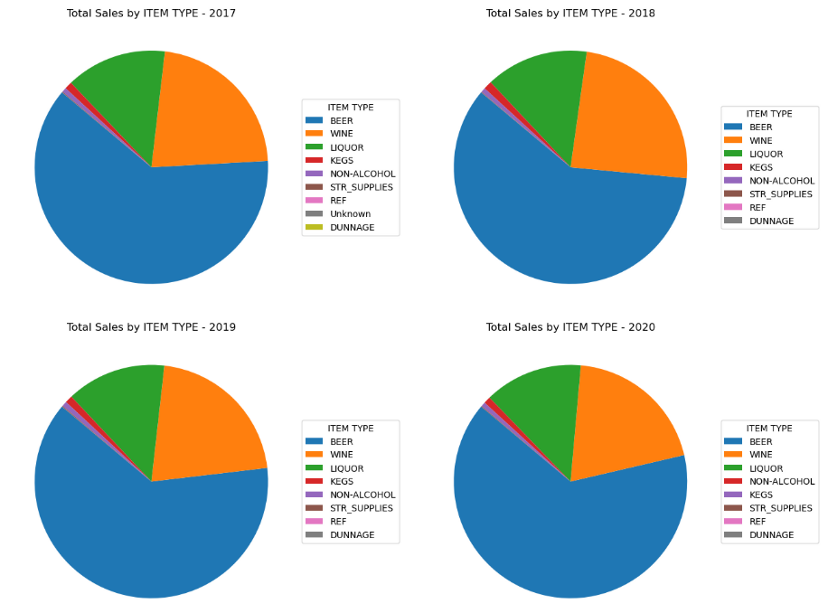
Data Visualization #3
Total Sales by ITEM TYPE – Pie Charts
2017: BEER dominated sales followed by LIQUOR and WINE.
2018: BEER remained the top product, while WINE slightly gained market share.
2019: BEER retained dominance, with stable performance by LIQUOR and WINE.
2020: BEER continued to lead, while LIQUOR remained consistent; other types showed minor changes.

Slide 12
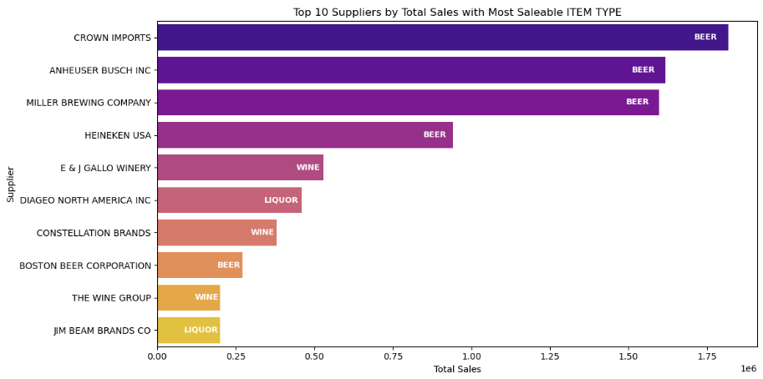
Data Visualization #4
Top 10 Suppliers by Total Sales with Most Saleable ITEM TYPE
- CROWN IMPORTS recorded the highest total sales, driven mainly by BEER products.
- The top four suppliers are all BEER-focused, highlighting beer’s dominance in sales.
- E & J GALLO WINERY and CONSTELLATION BRANDS led in WINE distribution.
- DIAGEO NORTH AMERICA INC and JIM BEAM BRANDS CO were top contributors in LIQUOR sales.

Slide 13
03
Feature Engineering
-> Creating feature_df DataFrame for Model Building

Slide 14
Feature Engineering
Created new features to enhance clustering performance, including ITEM TYPE and sales-based metrics such as RETAIL_SALES_MEAN, TOTAL_SALES, and SALES_2017–2020.
Feature Name
ITEM TYPE
RETAIL_SALES_MEAN
RETAIL_SALES_SUM
RETAIL_SALES_STD
RETAIL_TRANSFERS_MEAN
RETAIL_TRANSFERS_SUM
RETAIL_TRANSFERS_STD
WAREHOUSE_SALES_MEAN
WAREHOUSE_SALES_SUM
WAREHOUSE_SALES_STD
TOTAL_SALES
SALES_2017 to SALES_2020
Description
Product type identifier
Average retail sale per record
Total retail sales
Standard deviation of retail sales
Average retail transfer per record
Total retail transfers
Standard deviation of retail transfe
Average warehouse sale per recor
Total warehouse sales
Standard deviation of warehouse sales
Combined total of all sales types
Year-wise total sales from 2017 to 2020

Slide 15
04
Scaling & Model Building
-> Standard Scaling
-> Determine Optimal Number of Clusters
-> Applying & Evaluation of Models

Slide 16
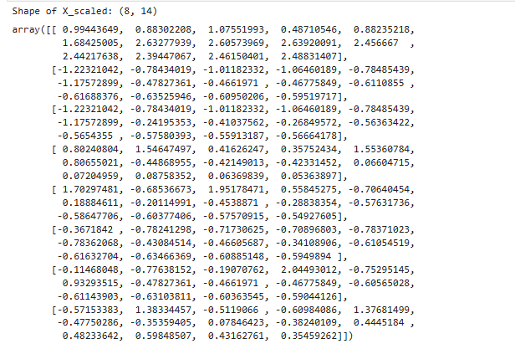
Standard Scaling
➤ Before applying clustering algorithms, it is important to scale the features to ensure that all variables contribute equally to the distance calculations. Features like total sales and standard deviations vary in magnitude, and without scaling, larger numerical ranges could dominate the clustering results.
Here, we used StandardScaler to standardize the data, transforming each feature to have a mean of 0 and a standard deviation of 1 expect ITEM TYPE column.

Slide 17
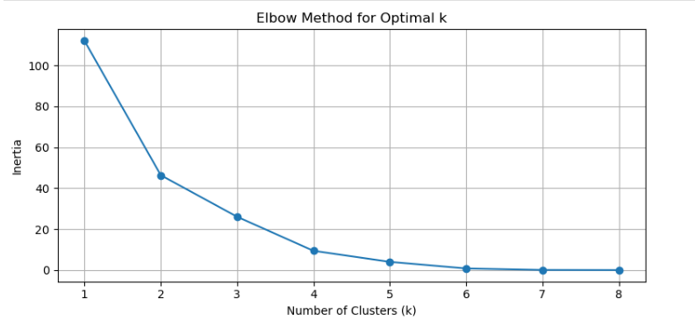
Determining Optimal K
Optimal Clusters Selection – Elbow Method
- The Elbow Method was used to find the ideal number of clusters for K-Means.
- A sharp drop in inertia is observed up to k=3, indicating strong clustering gains.
- The elbow point appears around k=3 or 4, beyond which gains diminish.
- To balance accuracy and simplicity, k=3 was selected for clustering.

Slide 18
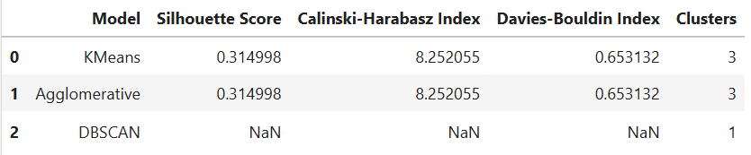
Model Building & Evaluation
Model Selection Strategy
Applied K-Means, Agglomerative Clustering, and DBSCAN to explore different clustering approaches.
Each model offers a unique perspective:
➤ K-Means – centroid-based
➤ Agglomerative – hierarchical
➤ DBSCAN – density-based
Using multiple models improves comparison and clustering robustness.
Goal: Identify the best method to group products by sales behavior for actionable insights.
Evaluation
- K-Means and Agglomerative Clustering produced identical performance across all three metrics:
- Silhouette Score: 0.3149
- Calinski-Harabasz Index: 8.25 -
- Davies-Bouldin Index: 0.6531
- DBSCAN failed to form meaningful clusters
Agglomerative Clustering was selected due to its ability to capture hierarchical relationships and better interpretability for this dataset.

Slide 19
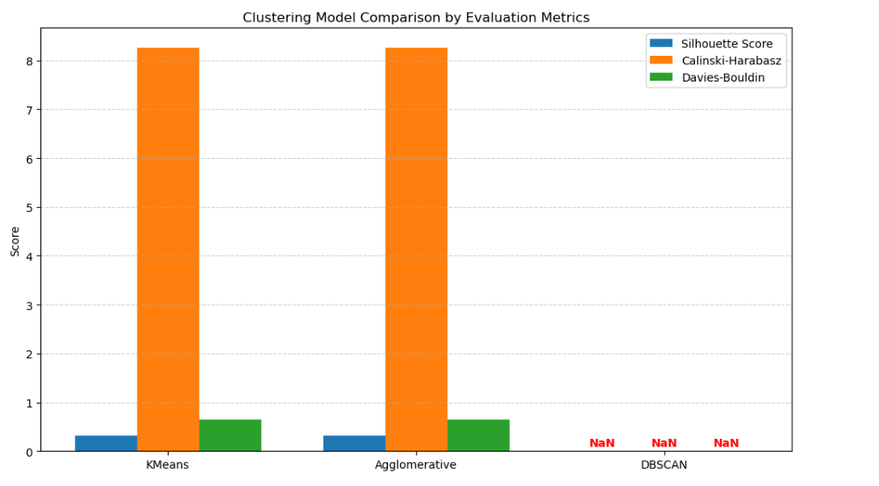
Evaluation Plotting
Model Evaluation Summary
- KMeans and Agglomerative Clustering showed identical scores across all metrics, indicating equal performance.
- Evaluation metrics suggest moderately well-separated and compact clusters for both models.
- DBSCAN failed to form valid clusters, assigning all data to a single group.
- Agglomerative Clustering was chosen for its hierarchical structure and better interpretability.

Slide 20
05
Cluster Projection
-> PCA Projection
-> Cluster Analysis
-> Cluster Plotting

Slide 21
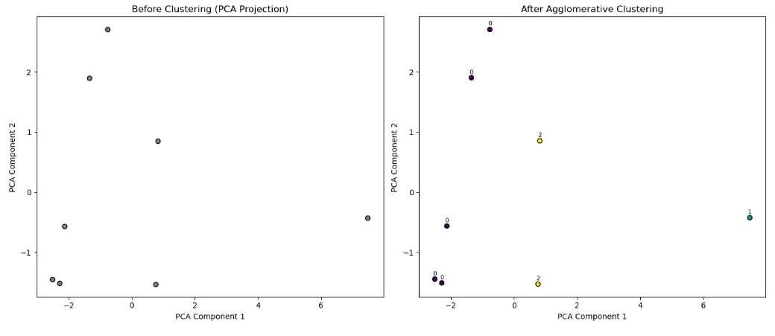
PCA Projection
Before Applying Agglomerative (PCA)
- No clear grouping observed; data appears scattered without visible cluster structure.
- One distant outlier suggests a product with unusual sales or distribution behavior.
After Applying Agglomerative (PCA)
- Three clear clusters formed, showing effective product differentiation by the model.
- Outlier isolated into its own cluster, reflecting a distinct product profile.

Slide 22
Cluster Analysis & Labelling
Cluster Analysis
- Cluster 0: Majority of products; average sales and transfers.
- Cluster 1: Single, high-performing product with very high sales.
- Cluster 2: Retail-focused products with lower warehouse sales.
- Clustering clearly separates low, average, and high-performing product types.
Cluster Labelling
- Cluster 0 – DUNNAGE: Low-volume, support products with moderate sales.
- Cluster 1 – BEER: Highest-performing product with strong sales across all channels.
- Cluster 2 – LIQUOR: Mid-range products with balanced sales, lower warehouse distribution.

Slide 23
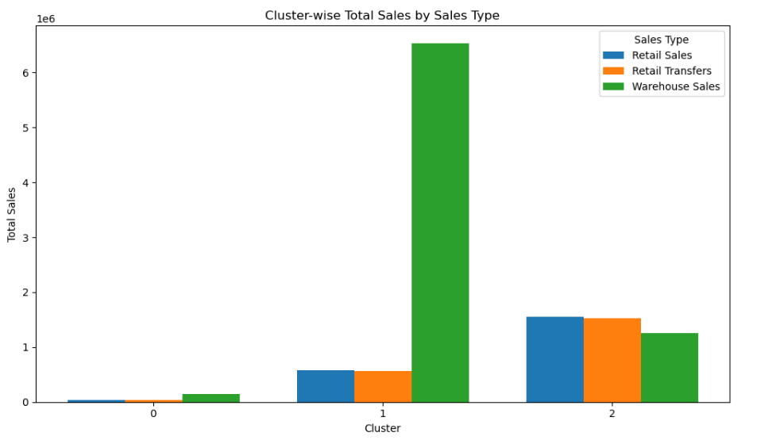
Cluster Plotting
Cluster Wise Sales Distribution
- Cluster 1 (BEER): Dominates sales, driven by high Warehouse Sales.
- Cluster 2 (LIQUOR): Balanced sales across Retail and Warehouse channels.
- Cluster 0 (DUNNAGE): Low sales overall, slightly more warehouse-dependent.
Sales patterns confirm clear role-based product segmentation through clustering

Slide 24
Thank You!
By: Rajnish Kashyap

